Slide 1
Minecraft-inspired Rock and Mineral Identification Game
Electrifying the Future

Slide 2
Name this mineral! (2 points)
COPPER

Slide 3
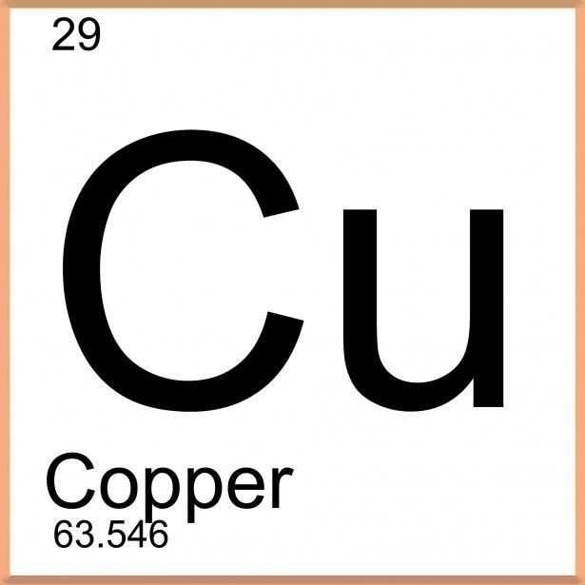
Where do we find Copper? (4 points)
Electric vehicles
Electric wires
Batteries
Car tires
A, B, and C
Answer:
If you answered e) you are correct! Copper is an important metal used in many everyday things, especially in the automotive industry. In electric cars, it’s used in the motor and wiring, with about 83 kg of copper in each vehicle! Copper conducts electricity well, making it essential for wires and devices. It's also crucial in batteries, helping them work better and last longer. Copper is everywhere and powers our daily lives.

Slide 4
Name this rock! (2 points)
DIORITE

Slide 5
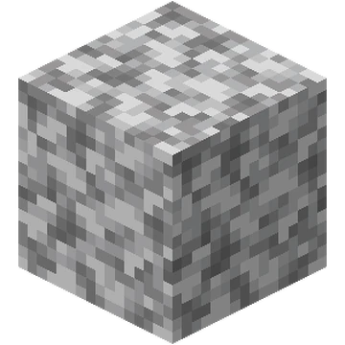
Identifying Diorite
Where might you find Diorite? (4 points) A beach A dessert Near volcanoes | What is Diorite’s typical appearance? (4 points) Solid and Blue Resembles oreo ice cream, black and white mix. Bright red
Answer: | Answer:
c). - Diorite is a rock often found near old volcanoes. It forms deep underground when hot, melted rock cools slowly. You can find diorite in places where volcanoes used to be, especially in mountains.
b). - Diorite has a mix of light and dark minerals, giving it a speckled look. The light and dark spots make it easy to identify.

Slide 6
Name this rock! (2 points)
COAL

Slide 7
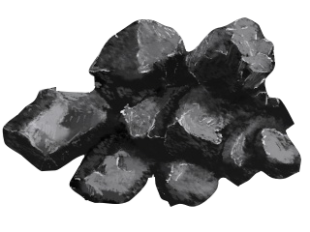
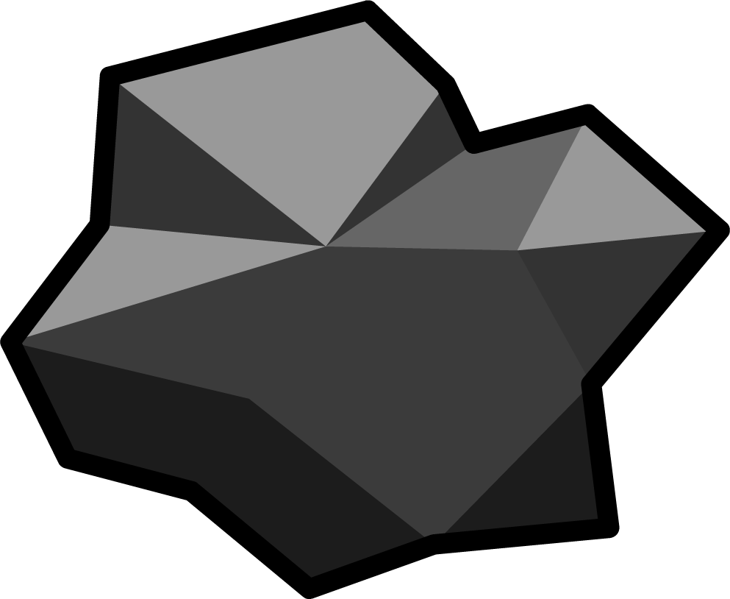
Identifying Coal
Coal can have a dull or a shiny appearance. (1 point)
Coal is a lightweight rock. (1 point)
True
False
True
False
Answer:
True
Answer:
True
Coal is light because it is mostly made of carbon, which is less dense than minerals in other rocks. It also has small air pockets that make it feel even lighter!
Coal contains organic carbon pieces, such as plant materials, that have been buried and pressed underground. Normally it is dull looking, but if it was buried close to a heat source, such as magma, it can be “baked” giving coal a shiny appearance.

Slide 8
Name the the metal that causes this red colour! (2 points)
IRON

Slide 9
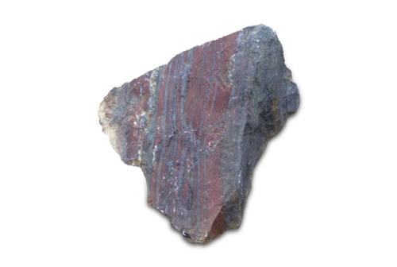
Identifying Iron
Iron is a mineral (4 points)
True
False
Why is iron important for making cars safe? (4 points)
It makes the cars colourful
It makes cars strong
It makes cars fly
It makes cars smell nice
Answer:
b) False: Iron is an element that makes up 2 minerals in these samples: Hematite (red) and magnetite (grey/black)
Answer:
b) - Iron allows us to build things that need to be strong and durable, like cars for example. In cars, strong iron parts help protect people by making the car sturdy.

Slide 10
Name this mineral! (2 points)
QUARTZ

Slide 11
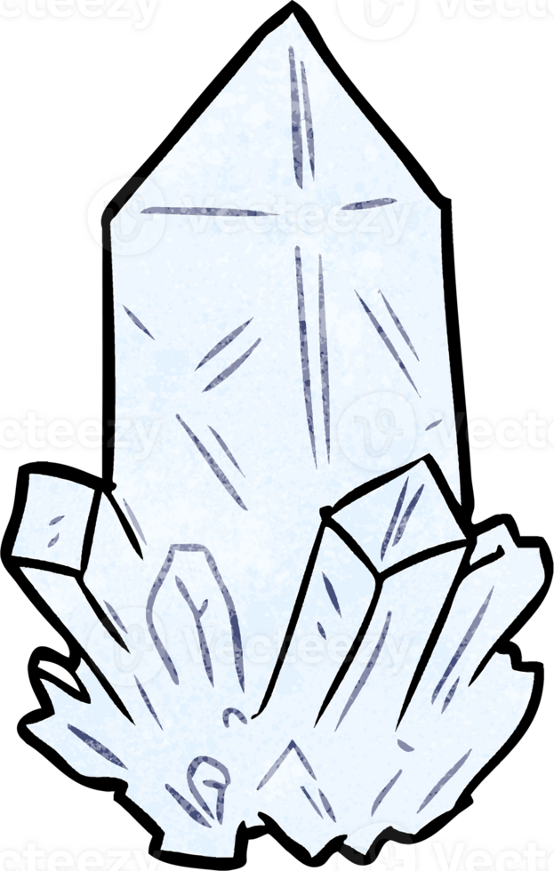
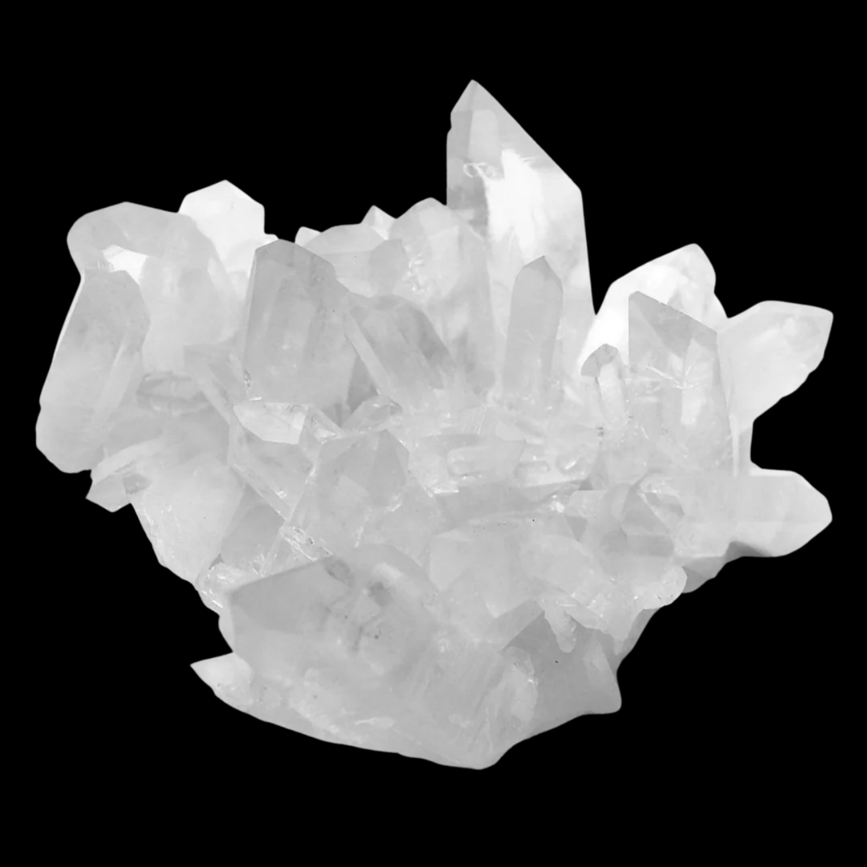
Identifying Quartz
(4 points)
(4 points)
What shape is the quartz in your box or pail?
Square like a box
Round like a ball
Flat like a coin
Long and pointy
Is quartz a hard or soft mineral?
Hard
Soft
Answer:
Answer:
a) Compared to most other white/clear minerals (other than diamond), quartz is relatively harder. It cannot be scratched by a fingernail, coin or knife!
d) - Quartz crystals often “grow” in a way that makes them look like long, pointy hexagonal sticks. They are clear or white and can have sharp tips!

Slide 12
Great job!
What’s your score?
?/40

